Slide 1
CEE 111 Engineering Drawing Lecture 3
Geometric Constructions

Slide 2
Geometric Constructions
Construction of primitive geometric forms (points, lines and planes etc.) that serve as the building blocks for more complicated geometric shapes.
Defining the position of the object in space.

Slide 3
Coordinate systems..
Choice is based on symmetry of problem
RECTANGULAR or Cartesian
CYLINDRICAL
Examples:
SPHERICAL
Sheets - RECTANGULAR
Wires/Cables - CYLINDRICAL
Spheres - SPHERICAL

Slide 4
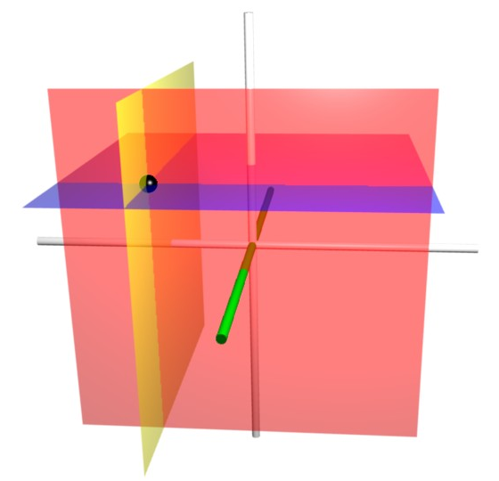
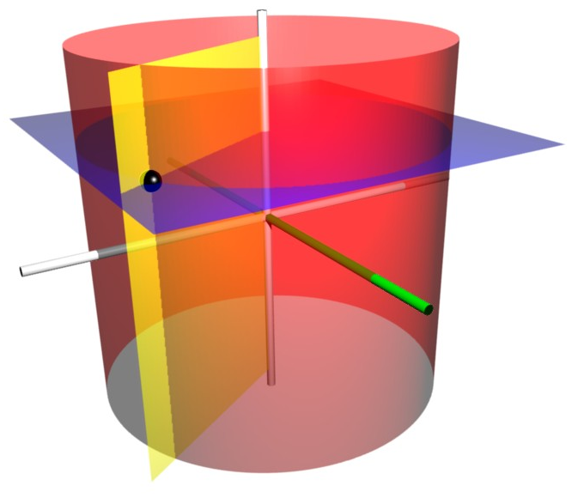
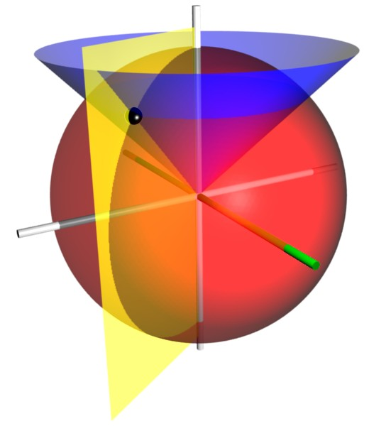
Orthogonal Coordinate Systems:
1. Cartesian Coordinates
z
Or
P(x,y,z)
y
Rectangular Coordinates
P (x, y, z)
x
2. Cylindrical Coordinates
z
z
Involves one angle and two distances
Specify a distance from the origin, an angle from the X-axis, and a distance in the Z-direction
P (r, Φ, z)
P(r, Φ, z)
x
r
y
Φ
3. Spherical Coordinates
z
Involves two angles and one distance
P (r, θ, Φ)
P(r, θ, Φ)
θ
r
y
x
Φ

Slide 5
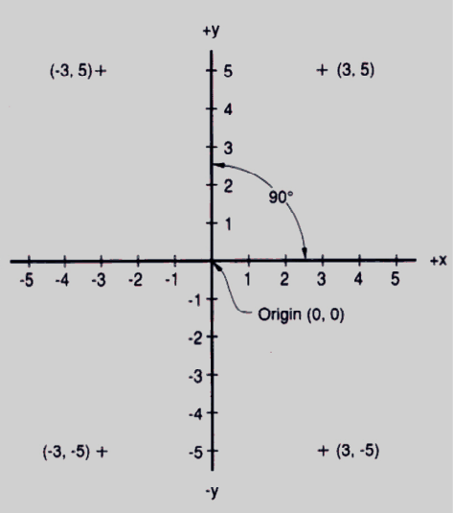
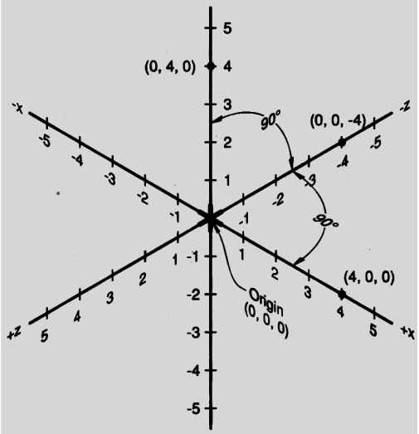
Cartesian coordinate system Locates the positions of the geometric forms in 2-D and 3-D space

Slide 6

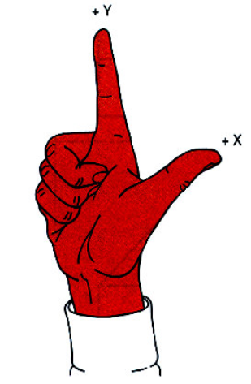
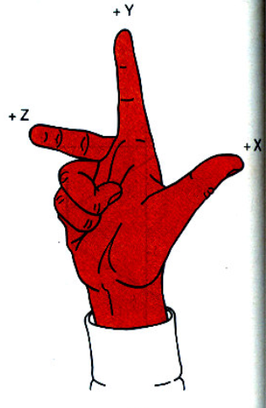
The right-hand rule
Used to determine the positive directions of the axes.
Used to specify the direction of positive rotation about each axis.
Is used in both traditional drawing and CAD.
Defines the X, Y, Z axes & +ve and –ve directions.

Slide 7
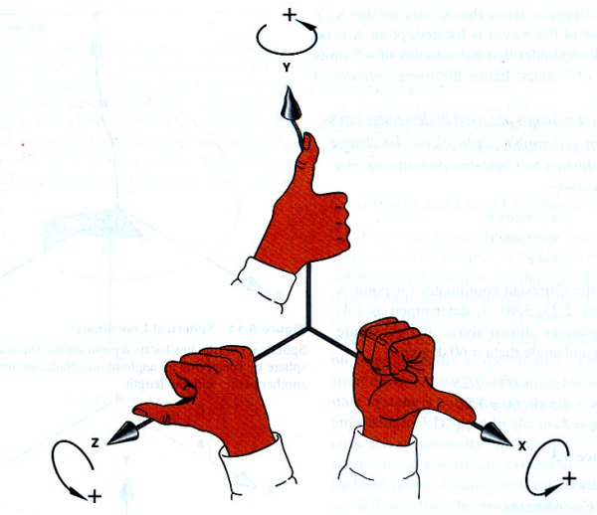
Defines the +ve and –ve directions of rotation on each axis

Slide 8
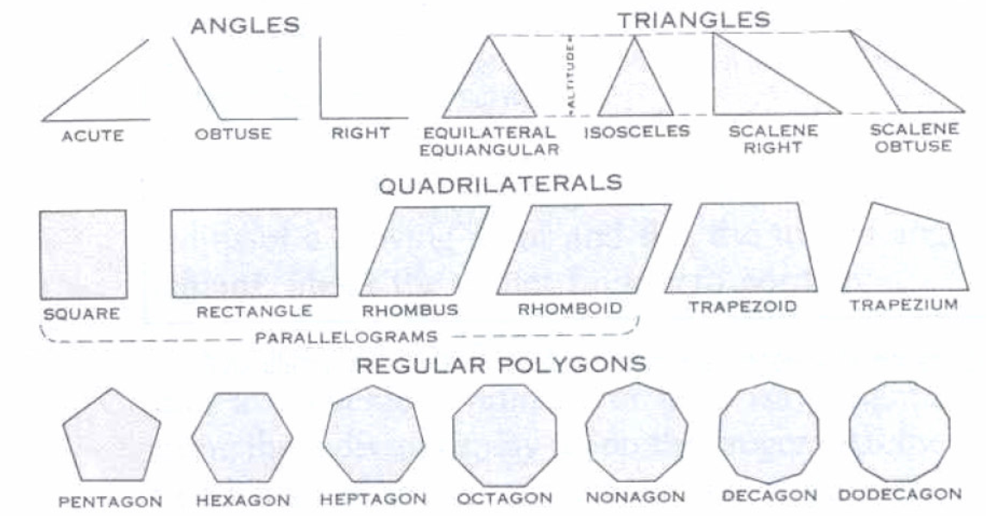
Lines and Planes

Slide 9

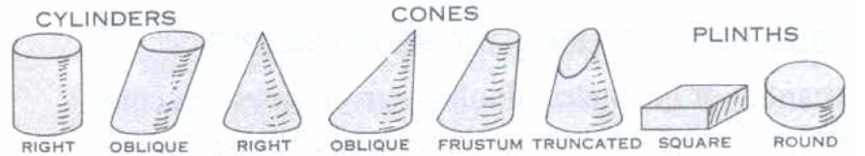

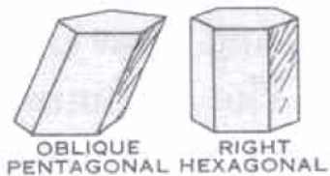
Solids

Slide 10
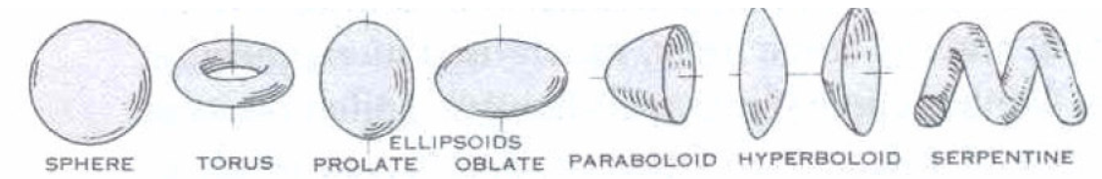
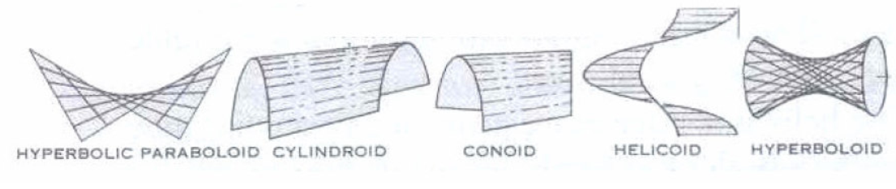
Curved surfaces

Slide 11
Primitive geometric forms
Point
Line
Plane
Solid
Doubly curved surface and object
Warped surface
Points, Lines, Circles, and Arcs:
The basic 2-D geometric primitives, from which other more complex geometric forms are derived.

Slide 12
Point
A theoretical location that has neither width, height, nor depth.
Describes exact location in space.
A point is represented in technical drawing as a small cross made of dashes that are approximately 3 mm long.
+

Slide 13
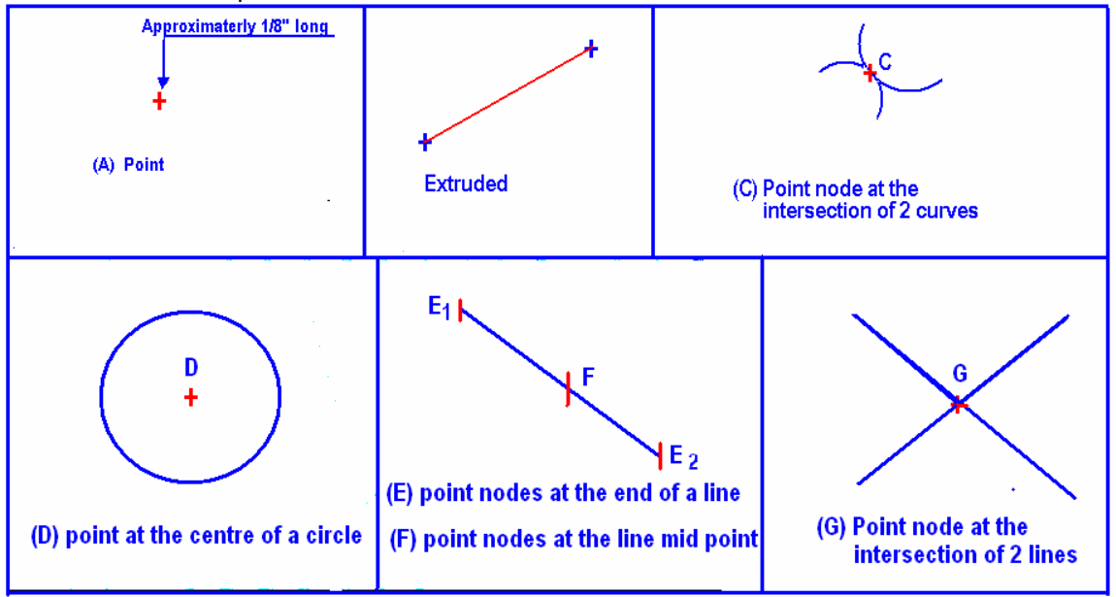
A point is used to mark the locations of centers and loci, the intersection ends, middle of entities.

Slide 14
Line
A geometric primitive that has length and direction, but no thickness.
It may be straight, curved or a combination of these.
Lines also have important relationship or conditions, such as parallel, intersecting, and tangent.
Lines – specific length and non-specific length.

Slide 15
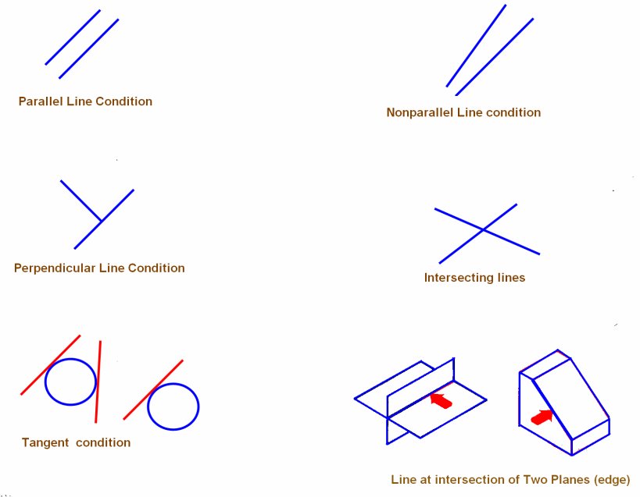
Relationship of one line to another line or arc

Slide 16
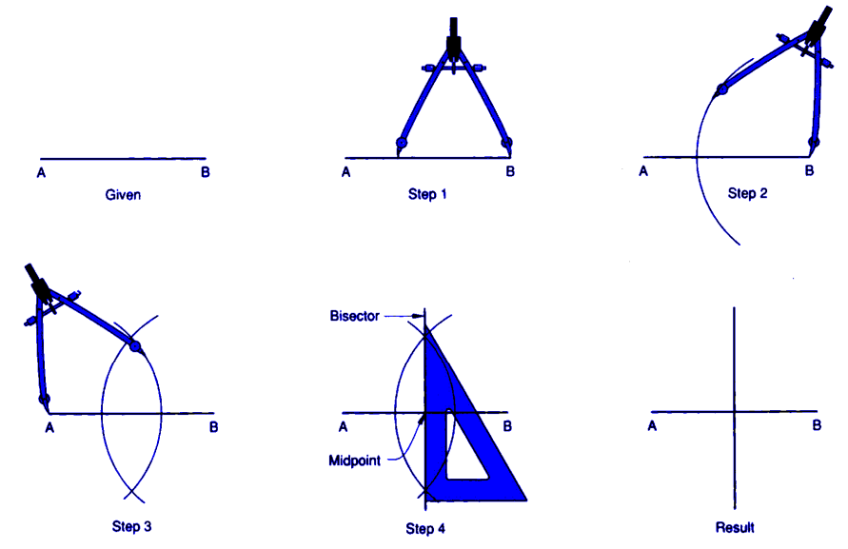
Bisecting a line

Slide 17
Parallel Lines??????

Slide 18
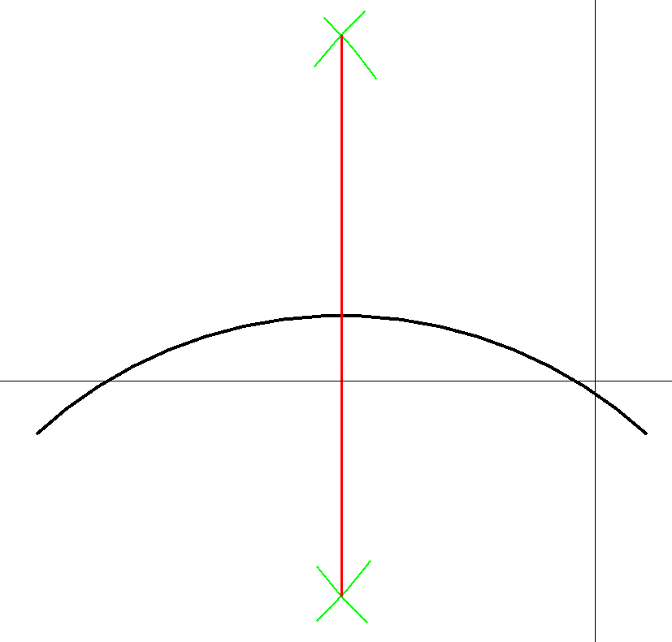
Bisect an Arc
An arc is a curved line and is bisected using the same steps.
Imagine a line between the end points of the arc.
Bisect the imagined line as you did to complete the perpendicular bisect

Slide 19
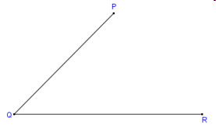
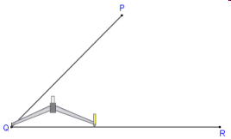
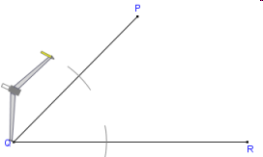
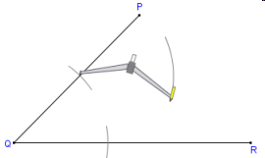
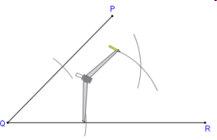
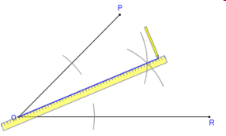
Bisect Angle
Place the compass point on the Vertex (Q) and adjust to a width approximately half the length of 1 leg of the angle.
Draw an arc across each leg of the angle.
Move the compass point to the intersection of one of the legs and arc.
Draw an arc in the interior of the angle.
Without changing the radius of the compass do the same on the other leg of the angle so the arcs intersect
Using a straight edge connect the vertex and intersection of the two arcs.

Slide 20
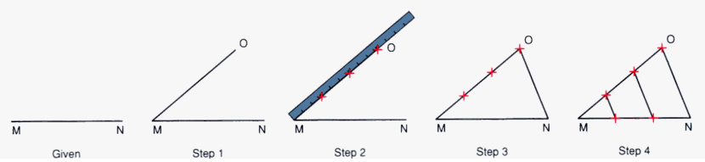
Dividing a line into equal parts
Steps:
Draw a line MO at any convenient angle (preferably an acute angle) from point M.
From M and along MO, cut off with a divider equal divisions (say three) of any convenient length.
Draw a line joining ON.
Draw lines parallel to ON through the remaining points on line MO. The intersection of these lines with line MN will divide the line into (three) equal parts.

Slide 21
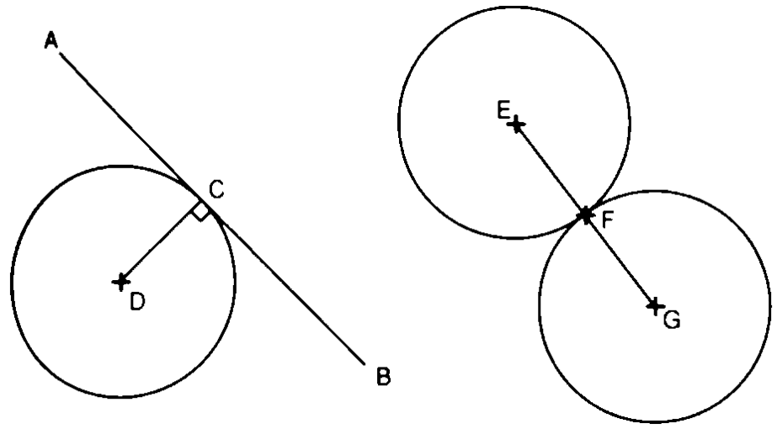
Planar tangent condition exists when two geometric forms meet at a single point and do not intersect

Slide 22
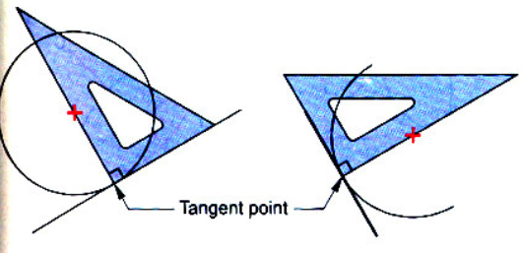
Locating tangent points on circle and arcs

Slide 23
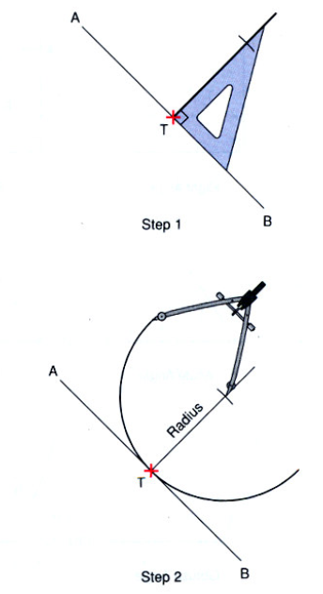
Drawing an arc tangent to a given point on the line
Steps
Given line AB and tangent point T. Construct a line perpendicular to line AB and through point T.
Locate the center of the arc by making the radius on the perpendicular line. Put the point of the compass at the center of the arc, set the compass for the radius of the arc, and draw the arc which will be tangent to the line through the point T.

Slide 24
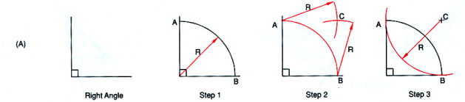
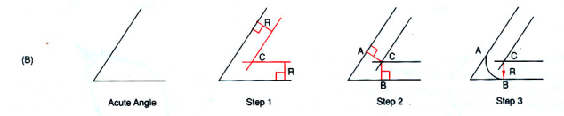
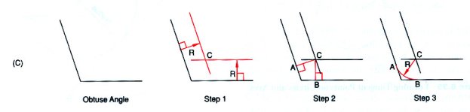
Drawing an arc, tangent to two lines
(a) At right angle
(b) At acute angle
(c) At obtuse angle

Slide 25
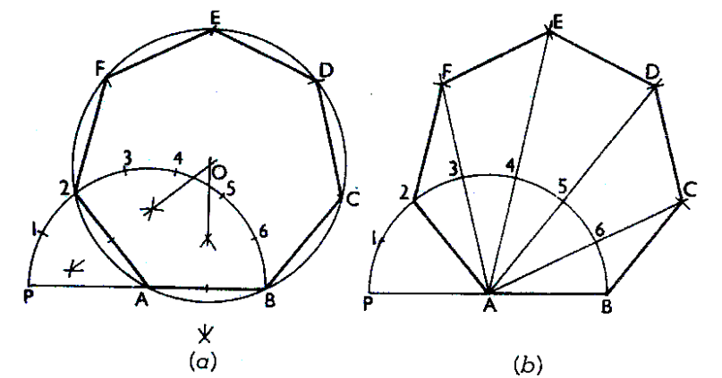
Construction of Regular Polygon of given length AB
Draw a line of length AB. With A as centre and radius AB, draw a semicircle
With the divider, divide the semicircle into the number of sides of the polygon????????
Draw a line joining A with the second division-point 2
The perpendicular bisectors of A2 and AB meet at O. Draw a circle with centre O and radius OA. With length A2, mark points F, E, D & C on the circumferences starting from 2 (Inscribe circle method)
With centre B and radius AB draw an arc cutting the line A6 produced at C. Repeat this for other points D, E & F (Arc method)

Slide 26
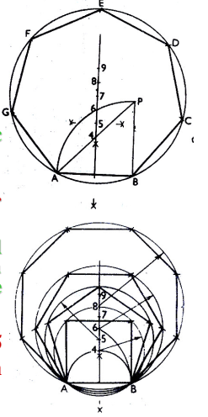
General method of drawing any polygon
Draw AB = given length of polygon
At B, Draw BP perpendicular & = AB
Draw Straight line AP
With center B and radius AB, draw arc AP.
The perpendicular bisector of AB meets st. line AP and arc AP in 4 and 6 respectively.
Draw circles with centers as 4, 5,&6 and radii as 4B, 5B, & 6B and inscribe a square, pentagon, & hexagon in the respective circles.
Mark point 7, 8, etc with 6-7,7-8,etc. = 4-5 to get the centers of circles of heptagon and octagon, etc.

Slide 27
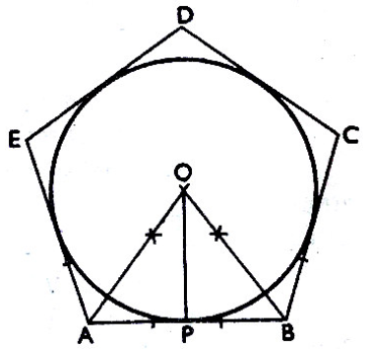
Inscribe a circle inside a regular polygon
Bisect any two adjacent internal angles of the polygon.
From the intersection of these lines, draw a perpendicular to any one side of the polygon (say OP).
With OP as radius, draw the circle with O as center.

Slide 28
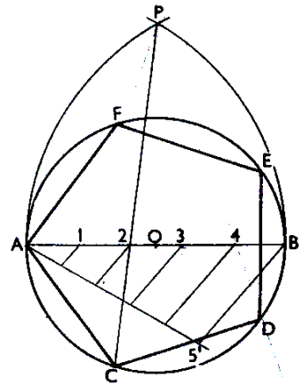
Inscribe a regular polygon of any number of sides (say n = 5), in a circle
Draw the circle with diameter AB.
Divide AB in to “n” equal parts
Number them.
With center A & B and radius AB, draw arcs to intersect at P.
Draw line P2 and produce it to meet the circle at C.
AC is the length of the side of the polygon.

Slide 29
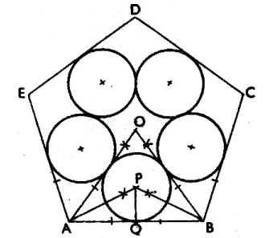
Inside a regular polygon, draw the same number of equal circles as the side of the polygon, each circle touching one side of the polygon and two of the other circles
Draw bisectors of all the angles of the polygon, meeting at O, thus dividing the polygon into the same number of triangles.
In each triangle inscribe a circle.

Slide 30
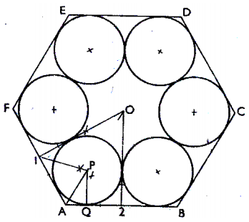
Inside a regular polygon, draw the same number of equal circles as the side of the polygon, each circle touching two adjacent sides of the polygon and two of the other circles
Draw the perpendicular bisectors of the sides of the polygon to obtain same number of quadrilaterals as the number of sides of the polygon.
Inscribe a circle inside each quadrilateral.

